Slide 1

Command Line Arguments
You can run a Java program by typing a command at the prompt in the command shell window
Called “invoking the program from the command line”
With this method, you can add extra information for the program to use
Called command line arguments
Example: start a program with a command line
javac ProgramClass.java
java ProgramClass -v input.dat
The program receives the strings "-v" and "input.dat" as command line arguments
Useful for automating tasks

Slide 2
Command Line Arguments
Your program receives its command line arguments in the args parameter of the main method:
public static void main(String[] args)
In the example, args is an array of length 2, containing the strings
args[0]: "-v”
args[1]: "input.dat"

Slide 3
Self Check 11.11
If the program is invoked with
java CaesarCipher -d file1.txt
what are the elements of args?
Answer: args[0] is "-d" and args[1] is "file1.txt"

Slide 4
Self Check 11.13
Will the program run correctly if the program is invoked with
java CaesarCipher file1.txt file2.txt –d
If so, why? If not, why not?
Answer: The program will run correctly. The loop that parses the options does not depend on the positions in which the options appear.

Slide 5
Exception Handling - Throwing Exceptions
Exception handling provides a flexible mechanism for passing control from the point of error detection to a handler that can deal with the error.
When you detect an error condition, throw an exception object to signal an exceptional condition
If someone tries to withdraw too much money from a bank account
Throw an IllegalArgumentException
IllegalArgumentException exception =
new IllegalArgumentException("Amount exceeds balance");
throw exception;

Slide 6
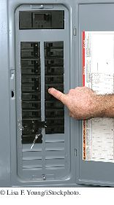
Exception Handling - Throwing Exceptions
When an exception is thrown, method terminates immediately
Execution continues with an exception handler
When you throw an exception, the normal control flow is terminated. This is similar to a circuit breaker that cuts off the flow of electricity in a dangerous situation.

Slide 7
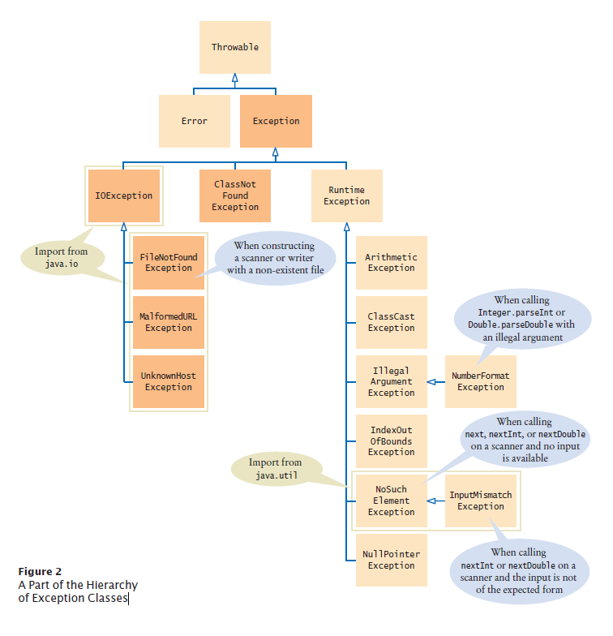
Hierarchy of Exception Classes
Figure 2 A Part of the Hierarchy of Exception Classes

Slide 8
Catching Exceptions
Every exception should be handled somewhere in your program
Place the statements that can cause an exception inside a try block, and the handler inside a catch clause.
try
{
String filename = . . .;
Scanner in = new Scanner(new File(filename));
String input = in.next();
int value = Integer.parseInt(input);
. . .
}
catch (IOException exception)
{
System.out.println(“There was an IOException from method xxx” + fileName);
exception.printStackTrace();
}
catch (NumberFormatException exception)
{
System.out.println(“There was an NumberFormatException from method xxx” + input);
System.out.println(exception.getMessage());
}

Slide 9
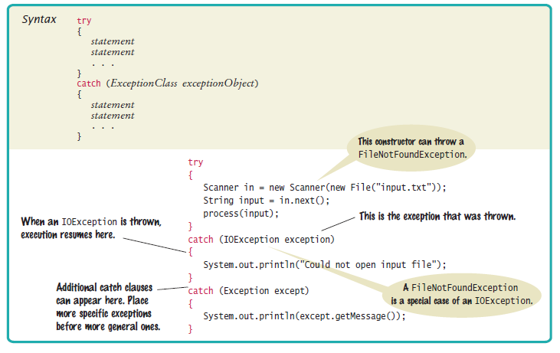
Syntax 11.2 Catching Exceptions

Slide 10
Checked Exceptions - throws
Often the current method cannot handle the exception. Tell the compiler you are aware of the exception
You want the method to terminate if the exception occurs
Add a throws clause to the method header
public void readData(String filename) throws FileNotFoundException
{
File inFile = new File(filename);
Scanner in = new Scanner(inFile);
. . .
}

Slide 11
Self Check 11.16
Suppose balance is 100 and amount is 200. What is the value of balance after these statements?
if (amount > balance)
{
throw new IllegalArgumentException("Amount exceeds balance");
}
balance = balance – amount;
Answer: It is still 100. The last statement was not executed because the exception was thrown.

Slide 12
Self Check 11.17
When depositing an amount into a bank account, we don’t have to worry about overdrafts—except when the amount is negative. Write a statement that throws an appropriate exception in that case.
Answer:
if (amount < 0)
{
throw new IllegalArgumentException("Negative amount");
}

Slide 13
Self Check 11.19
Why is an ArrayIndexOutOfBoundsException not a checked exception?
Answer: Because programmers should simply check that their array index values are valid instead of trying to handle an ArrayIndexOutOfBoundsException.

Slide 14
Self Check 11.20
Is there a difference between catching checked and unchecked exceptions?
Answer: No. You can catch both exception types in the same way, as you can see in the code example on page 536.

Slide 15
If you heard no message upload: “Is it summer yet?!?!”

